Slide 1

IET Lucknow · AKTU · B.Tech CSE
Hirely
AI POWERED JOB PORTAL
Full-Stack Web Application with AI-Driven Resume Scoring,
Voice Interviews & Smart Job Matching
Submitted by: Pranjal Chaudhary (2200520100132) Harsh Singh (2200520100124)
Guided by: Prof. Dr. M. H. Khan Km. Deepu Yadav
JUNE 2026

Slide 2




HIRELY – AI POWERED JOB PORTAL
Overview
Hirely is a comprehensive AI-powered job portal that bridges the gap between job seekers and employers through intelligent automation at every stage of the recruitment lifecycle.
Job Seekers
Employers
AI Engine
Tech Stack
AI resume scoring, cover letter generation, voice mock interviews & application tracking
Intelligent candidate ranking, bulk resume analysis with TF-IDF, hiring pipeline management
Google Gemini AI, VAPI voice platform & scikit-learn ML for multi-factor scoring
Next.js 16 · React 19 · Django 5.2 · PostgreSQL · Docker · TypeScript · Tailwind CSS

Slide 3

Introduction
Implementation: Process & Tools
1
7
Motivation
AI Features
2
8
AGENDA
Problem Statement & Objectives
Performance & Testing
3
9
Literature Review
Conclusion
4
10
Existing vs Proposed Methodology
Future Scope
5
11
System Architecture
References
6
12

Slide 4



Introduction
40%
of GDP in emerging economies comes from SMEs — yet most lack intelligent tools to manage their workforce and hiring.
Discovery Gap
Candidates can't find right-fit roles; employers miss quality talent
The recruitment landscape has been transformed by online portals, but most function as simple listing boards with no AI intelligence.
Resume Problem
Employers spend countless hours reviewing hundreds of applications while candidates struggle to tailor their profiles.
Generic resumes fail ATS filters, blocking qualified candidates
LLMs, NLP, and Voice AI have opened unprecedented possibilities for automating and enhancing the recruitment process.
Interview Prep
Hirely addresses these gaps with a unified, intelligent platform accessible through a modern web interface.
Limited access to realistic interview practice resources

Slide 5

Motivation
SMEs & Employment
SMEs represent a significant portion of global employment. Their financial and workforce stability directly impacts economic growth and job creation. Better hiring tools → enhanced productivity → increased investments.
MERN / Modern Stack
The modern full-stack (Next.js, Django, PostgreSQL) is celebrated for flexibility and efficiency in building scalable, data-driven web applications — ideal for an intelligent recruitment platform.
ML in Industry
A McKinsey & Company (2021) study reveals ML adoption boosts operational efficiency by 20–30%. Applying ML to recruitment empowers SMEs with predictive analytics previously only available to large enterprises.

Slide 6
Problem Statement & Objectives
❗ Problem Statement
🎯 Objectives
Traditional job portals face critical limitations. Businesses struggle to extract actionable insights from candidate data due to:
• No actionable feedback for candidates on improving their applications for specific roles
• Employers lack efficient tools to automatically rank candidates by job fit
• Candidates have limited access to realistic interview preparation resources
• Cover letter creation is time-consuming and often generic
These gaps result in inefficient hiring pipelines, high drop-off rates, and poor matching quality.
1
AI-driven resume scoring using multi-factor NLP analysis (TF-IDF cosine similarity)
2
Google Gemini AI integration for personalised cover letter generation
3
VAPI voice interview module for realistic mock interview practice
4
Smart job search and matching based on candidate skills & experience
5
Employer dashboard for ranking, reviewing & managing candidate applications
6
Secure, scalable, containerised full-stack application ready for cloud deployment

Slide 7
Literature Review
Author / Source
Year
Key Findings
Methods
Limitations
Santos Lavrador et al.
2019
Dashboards for hotel industry using Excel with BI add-ins provide actionable financial insights
Case study of 5 hotels; Power Pivot & Power View
Small sample size; Excel lacks scalability for real-time analysis
Bharadwaj & Pal
2011
ML classifiers can predict job candidate success based on academic & professional features
Structured ML classifiers on academic/professional data
Relies on structured data & manual feature engineering
Salton & McGill
1983
TF-IDF vectorisation for resume-to-job-description matching is computationally efficient
TF-IDF + Cosine Similarity for text retrieval
Lacks semantic understanding; purely keyword-based
Google DeepMind
2023
Gemini AI exhibits strong capabilities for structured document analysis & text generation
Multimodal LLM training; API-based integration
Requires API access; on-premise deployment is resource-heavy

Slide 8
Existing vs Proposed Methodology
❌ Existing System
✅ Hirely – Proposed System
✗ Static Excel / PowerPoint files with no real-time data
✓ Pre-built, user-friendly — no technical expertise needed
✗ Complex BI tools (Tableau, Power BI) require expertise
✓ Upload CSV/data → instant interactive dashboards
✗ Time-consuming, error-prone manual processes
VS
✓ AI resume scoring with TF-IDF cosine similarity (0–5 scale)
✗ Outdated, non-interactive reports
✓ Gemini AI powered cover letter generation
✗ No AI-based resume ranking or analysis
✓ VAPI voice-based mock interview module
✗ Limited or no interview preparation tools
✓ Smart job matching & real-time application tracking
✗ No automated cover letter generation
✓ Docker containerised, CI/CD ready for cloud deployment

Slide 9



System Architecture
Three-Tier Client-Server Architecture
PRESENTATION TIER
APPLICATION TIER
DATA TIER
Next.js 16 SPA + React 19
Django 5.2 REST API
PostgreSQL on Neon Cloud
App Router based navigation
accounts · jobs · applications
PostgreSQL 15 (Neon Cloud)
Tailwind CSS + Shadcn/ui
▶
resumes · interviews modules
▶
Local file storage for resumes
Prisma ORM for frontend DB
JWT authentication on all routes
Prisma ORM (frontend)
VAPI SDK integration for voice
Google Gemini AI integration
Django ORM (backend)
React hooks for state management
scikit-learn ML resume scoring
Docker containerised DB

Slide 10
Comparison: Existing vs Proposed System
Aspect
Existing System
Hirely – Proposed
Data Visualization
Static numeric values in Excel or PowerPoint
Interactive charts, graphs & trend analysis
Interactivity
Limited, no drill-down into detailed metrics
Fully interactive with drill-down capabilities
Scalability
Difficult to scale; significant manual effort
Easily scalable with large data volume support
Decision Support
Relies heavily on intuition & basic reporting
Data-driven via predictive analytics & AI insights
Export Options
Limited export capability
PDF, Excel, CSV export for offline access & sharing
Resume Ranking
Manual review by HR personnel
AI TF-IDF cosine similarity scoring (0–5 scale)

Slide 11

Implementation: Process
Data Collection & Storage
01
Collecting, cleaning, and storing user and job data in PostgreSQL (Neon Cloud). PDF resume uploads stored with PyPDF2 text extraction pipeline for a strong data foundation.
Core Development: Backend & APIs
02
Django 5.2 REST API with five applications: accounts, jobs, applications, resumes, interviews. JWT authentication secures all endpoints. CSV upload and processing features built.
UI: Frontend Development
03
Next.js 16 App Router with React 19. Tailwind CSS + Shadcn/ui for modern responsive design. Recharts for data visualisation. VAPI SDK integration for voice interview interface.
AI & Machine Learning Integration
04
TF-IDF cosine similarity with multi-factor bonuses for resume scoring. Google Gemini AI for cover letter generation & ATS analysis. VAPI for voice-based mock interviews.

Slide 12
Implementation: Technology Stack
Frontend
Backend
Database
AI / ML
DevOps / CI
Next.js 16
Django 5.2
PostgreSQL 15
Google Gemini
Docker
React 19
Python 3.12
Neon Cloud
VAPI Voice AI
Docker Compose
TypeScript 5.x
Django REST
Django ORM
scikit-learn
Jenkins
Tailwind CSS 3
JWT (simplejwt)
Prisma 6.18
NumPy 1.26
GitHub Actions
Shadcn/ui
Prisma ORM
File Storage
PyPDF2
Cloud Deploy

Slide 13

Core AI Features
AI Resume Scoring
Gemini AI Cover Letter
VAPI Voice Interviews
TF-IDF cosine similarity on resume vs. job description. Multi-factor bonuses for skills, education & experience. Score 0–5 with colour coding: Excellent (4.0+) · Good (3.0) · Fair (2.0) · Low
Paste any job description → receive a fully personalised, ATS-optimised cover letter via Google Gemini AI API. Tailored tone, keywords & structure for each application.
Real-time AI voice interview agent. Choose Technical, Behavioral, or Mixed. Select experience level (Entry/Mid/Senior/Lead) & tech stack. Session recordings stored for replay.
Employer Ranking Dashboard
Smart Job Matching
Security & Auth
Analyze all candidates for a job posting in one click. View ranked list by AI score with skill match highlights. Custom re-ranking by modifying job description criteria.
Multi-attribute filtering: category, level, type, location & salary range. AI match indicator on each job card. Resume-based pre-application analysis before applying.
JWT-based auth with token refresh. Password hashing via Django auth utilities. Role-based access control: Job Seekers vs. Employers. Protected API endpoints.

Slide 14



Performance Metrics & Testing
2–3s
3–5s
<1.5s
Resume Scoring Time
Cover Letter Gen
Page Load Time
<200ms
40+
75%+
API Auth Response
Automated Tests
Code Coverage
Test Suite: Authentication (15 tests · 90%+ target) Resume Scoring (20+ tests · 85%+ target) Jobs & Applications (15+ tests · 80%+ target)

Slide 15
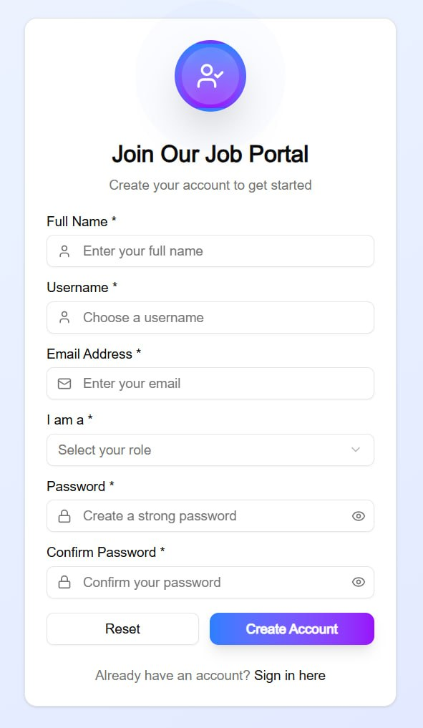
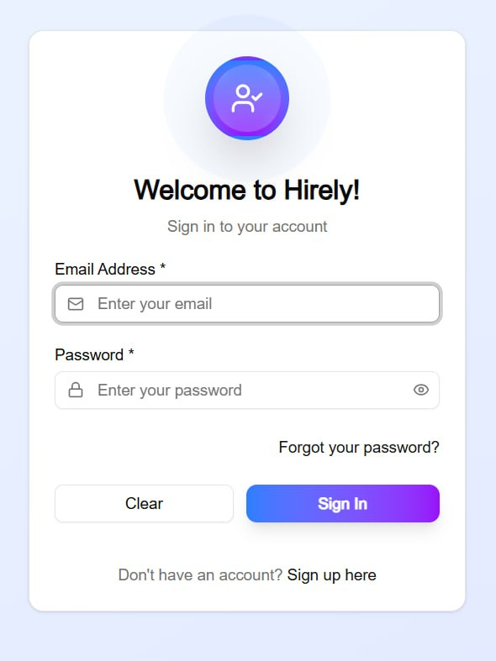
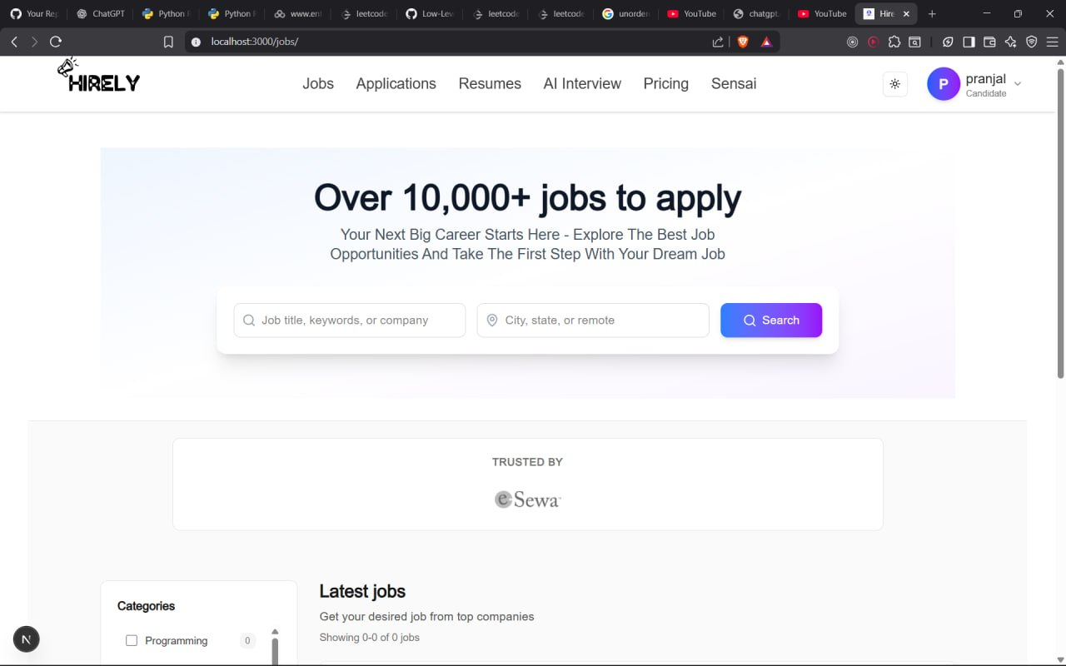
Sample User Interface Design
Figure 1. Sign Up page Figure 2. Sign in Page Figure 3. Landing Page

Slide 16
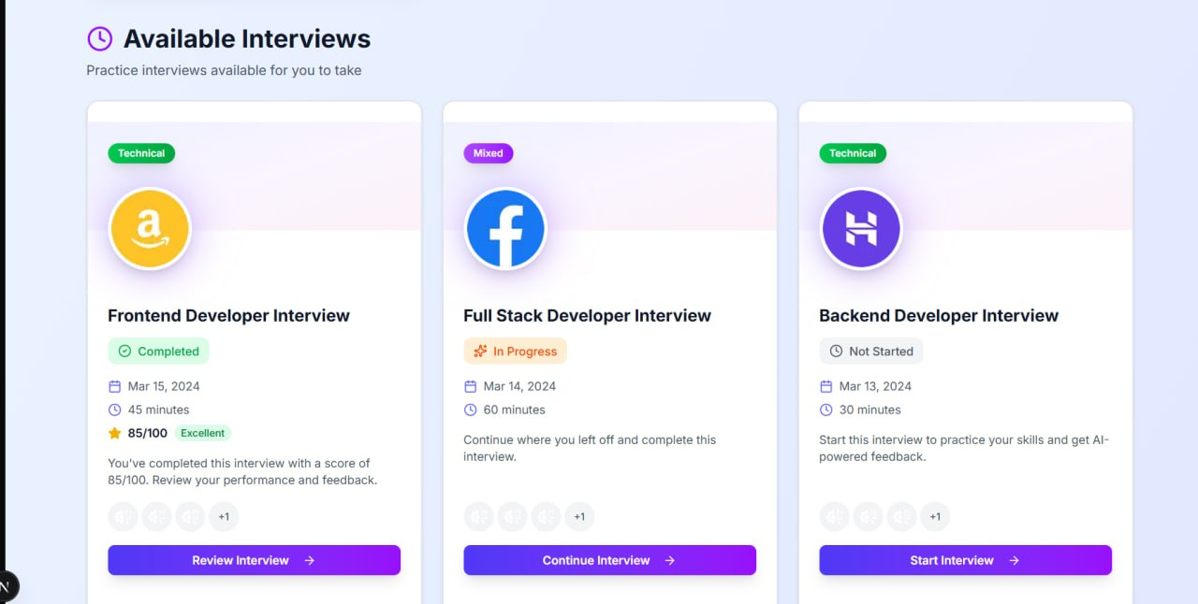
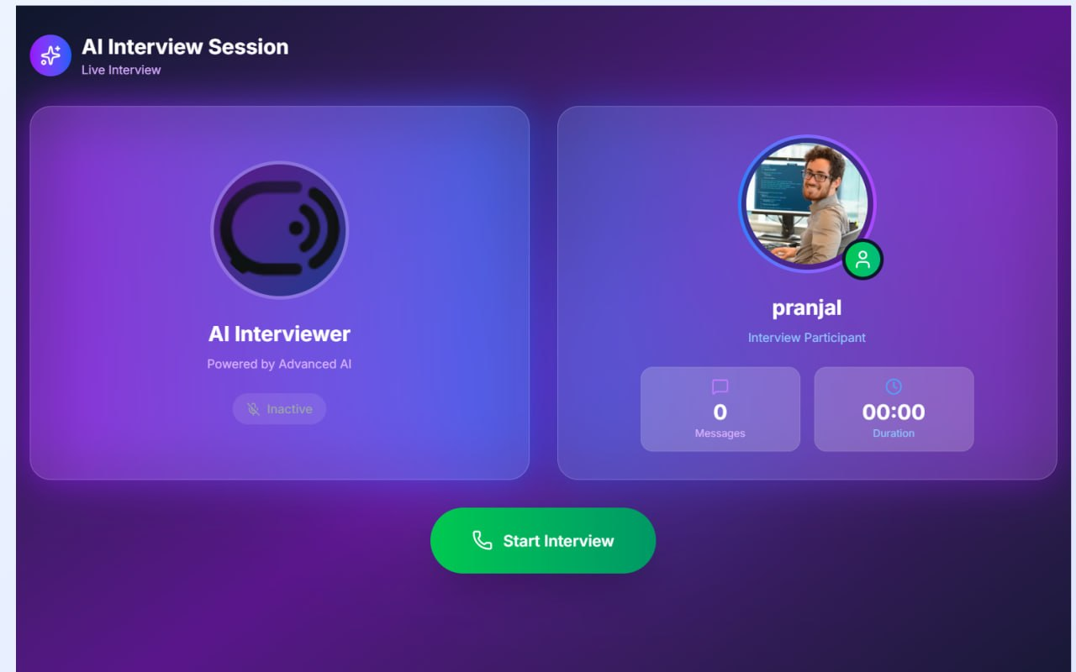
Sample User Interface Design
Figure 5. Job Page Figure 6. AI Interview

Slide 17

Conclusion
Intelligent Resume Scoring
Gemini AI Integration
The AI scoring module using TF-IDF cosine similarity with multi-factor bonuses demonstrated effective candidate ranking in experimental evaluations with high relevance.
Google Gemini AI for cover letter generation and ATS analysis provided job seekers with actionable, personalised guidance tailored to specific job descriptions.
Voice Interview System
Production-Ready Architecture
The VAPI-based voice interview system successfully delivered interactive, role-specific mock interviews supporting candidate preparation for real-world scenarios.
Next.js 16, React 19, Django 5.2, PostgreSQL, and Docker demonstrate a scalable AI job portal built with modern open-source technologies and CI/CD pipeline.

Slide 18




Future Scope
Replace TF-IDF with transformer-based models (BERT, Sentence-BERT) for semantic scoring
Real-time notifications via WebSockets / Server-Sent Events for application status updates
Recommendation engine to proactively suggest relevant jobs based on profile & browsing history
Video interview analysis with facial expression & sentiment analysis for comprehensive assessment
Mobile application using React Native for on-the-go access for job seekers and employers
Redis caching for resume analysis results to reduce repeat processing time below 1 second
Expand quiz coverage to 25+ technical domains with adaptive difficulty based on performance
Rate limiting, file virus scanning, NER with spaCy/Hugging Face for enhanced security & accuracy

Slide 19
References
[1] Singh et al., IEEE, 2024 — Resume Ranking with TF-IDF, Cosine Similarity and NER
Khatri et al., IJRESM, 2025 — AI-Powered Automated Resume Screening using NLP and ML
[2]
[3] Jabarian & Henkel, SSRN, 2025 — Voice AI in Firms: A Natural Field Experiment on Automated Job Interviews
[4] Jagtap et al., Indian J. Sci. Tech., 2025 — AI-Driven Real-Time Interview Simulation with Voice & Facial Analysis
[5] Google DeepMind, Gemini: A Family of Highly Capable Multimodal Models, Technical Report, 2023.
[6] Docker Documentation. Available: https://docs.docker.com. Accessed: May 2026.
[7] Docker Documentation. Available: https://docs.docker.com. Accessed: May 2026.
[8] Next.js Documentation. https://nextjs.org/docs. Accessed: May 2026.
[9] Django REST Framework Documentation. https://www.django-rest-framework.org. Accessed: May 2026.
[10] VAPI Voice AI Platform Documentation. https://vapi.ai/docs. Accessed: May 2026.

Slide 20
Thank You!
Hirely – AI Powered Job Portal
Pranjal Chaudhary · 2200520100132
Harsh Singh · 2200520100124
Dept. of Computer Science & Engineering · IET Lucknow · AKTU · 2026

